Slide 1

Us Air Quality Prediction
Supervisor :
Eng. Abdulrahman Mohamed
Prepared by :
Mahmoud Mohamed Eisa

Slide 2
Overview
Introduction
Data Wrangling
Exploratory Data Analysis
Machine Learning Modeling and Deployment
Conclusion

Slide 3
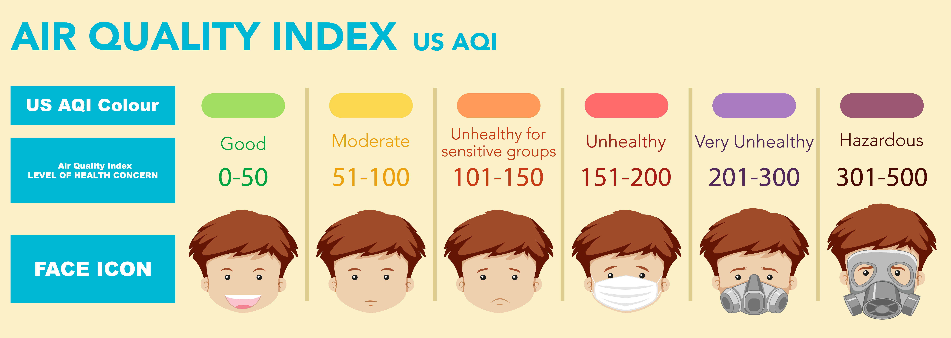
Introduction
In the past few years, the problem of air pollution in the United States has been increasing for several factors such as the damage caused by the ozone hole and the increase in the density of harmful particles from the air such as carbon monoxide, nitrogen dioxide, carbon dioxide and fine particles, so the United States is keen to study the level of air quality Throughout the day by air quality index, AQI is the primary way to measure the current quality of the air. AQI values range from 0-500 with 0 being perfectly healthy and 500 being extremely hazardous.

Slide 4
This issue take a lot of time during all the day to measure, through this project will study the probability of prediction of air quality index depend on old measurement during last forty years to save time and cost.
Dataset Describe
5617325 Rows
15 Features
Each row represent average test of all measurement of AQI along all day.
8 Numerical Columns
7 Categorical Columns
From Kaggle

Slide 5
Data Wrangling
Feature Extract & Transform
Load & Explore
Clean
Load csv file, explore first five rows, sort values by date.
check duplicates values and drop, dealing with missing data.
Extract year, month, day and square kilometer.

Slide 6
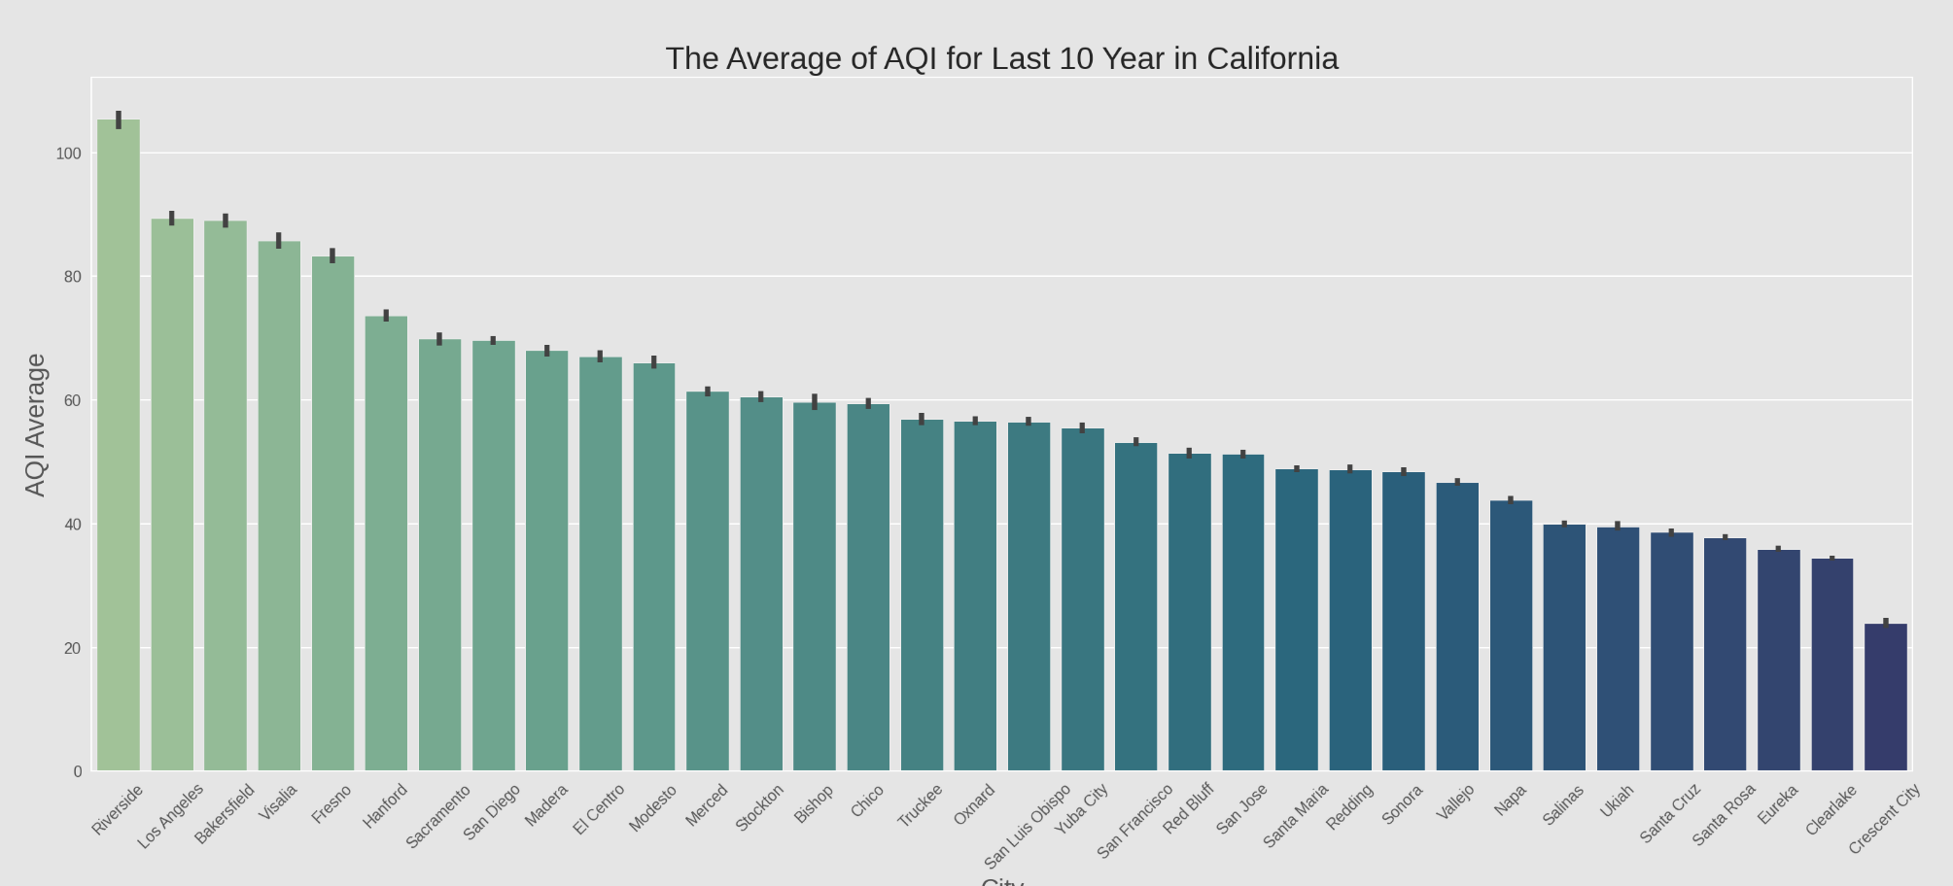
Exploratory Data Analysis
Q 1
What's the average of AQI for last 10 year in California for each City ?

Slide 7
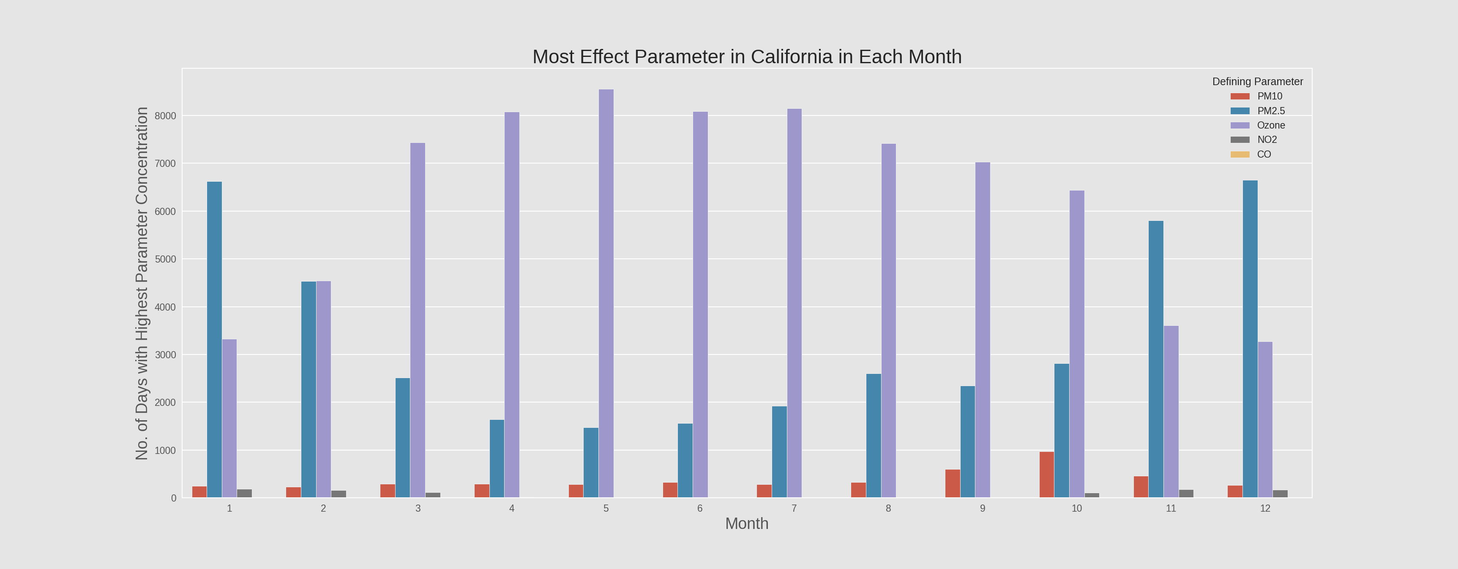
Q 2
What's the highest parameter concentration along months in California ?

Slide 8
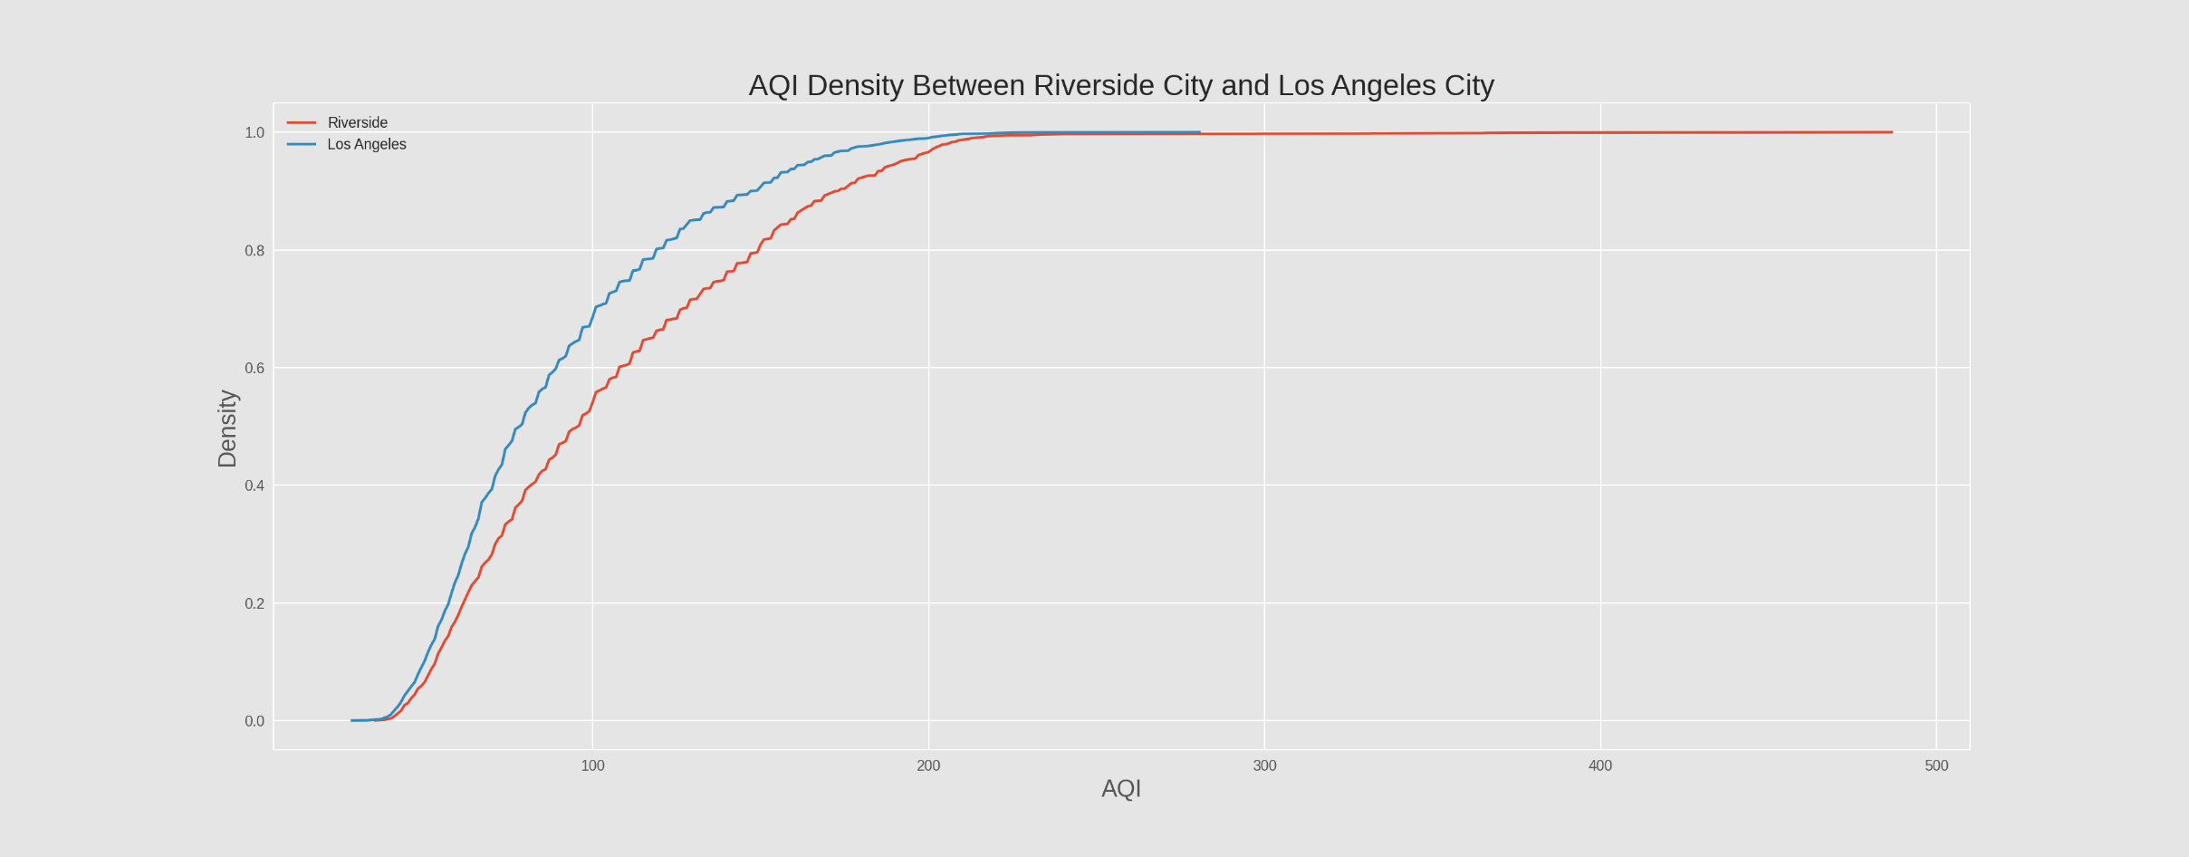
Q 3
compare between Riverside city and Los Angeles city which one have better AQI ?

Slide 9
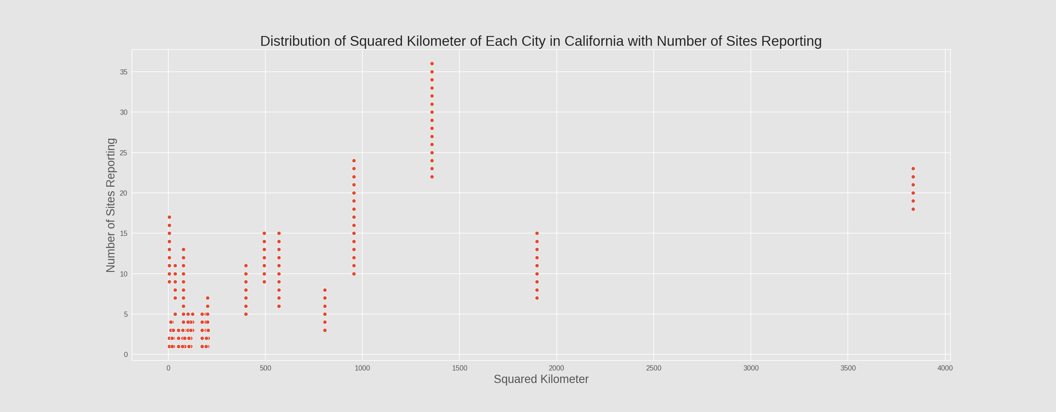
Q 4
Does the area of the city in square kilometers affect on the Number of Sites Reporting
needed to measure AQI (in California) ?

Slide 10
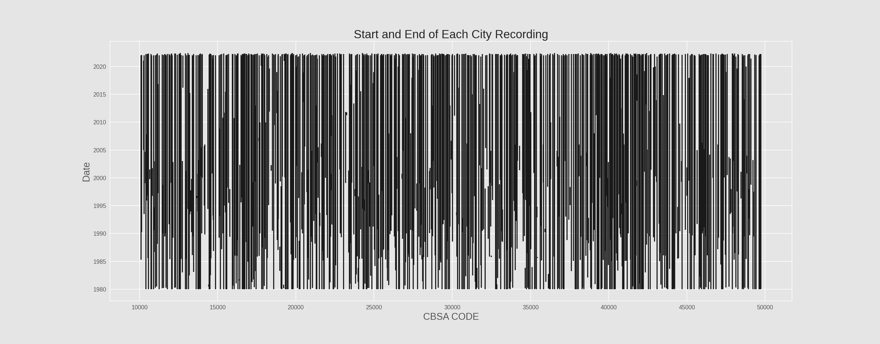
Q 5
what's the reason behind the increasing in number of testing in last decade ?

Slide 11
Machine Learning Modeling and Deployment
Preprocessing
Classification
Modeling pass through three stages before deployment.
Preprocessing
Classification model
Regression model
Regression
Deployment

Slide 12
Preprocessing
Take sample
Split to train / test
Features selection
Create preprocessing pipeline

Slide 13
Classification Model
Algorithms to train
Logistic Regression
Decision Tree
XGBoost
Random Forest
Naive Bayes
Kneighbors

Slide 14
Model | Logistic Regression | KNeighbors | Naive Bayes | Decision Tree | Random Forest | XGBoost
f1-score (0) | 0.876426288 | 0.898091572 | 0.29078114 | 0.897899216 | 0.910048716 | 0.884012731
f1-score (1) | 0.227902439 | 0.56025796 | 0.177482229 | 0.598831848 | 0.610147127 | 0.306014968
f1-score (2) | 0.010928962 | 0.24671916 | 0.016633775 | 0.313405797 | 0.316248637 | 0.071917808
f1-score (3) | 0 | 0.248962656 | 0.00474475 | 0.404833837 | 0.452054795 | 0.114285714
f1-score (4) | 0 | 0.347826087 | 0.006550543 | 0.533333333 | 0.561403509 | 0.565217391
f1-score (5) | 0 | 0 | 0.001884422 | 0 | 0 | 0
accuracy | 0.781720877 | 0.823911462 | 0.167229554 | 0.823833524 | 0.841863244 | 0.794606672
Its seem random forest is the best model to train, but otherwise there is high overfitting with it similar with kneighbors and decision tree, after hyper parameters tuning still overfitting and low accuracy, so will try XGBoost
XGBoost

Slide 15
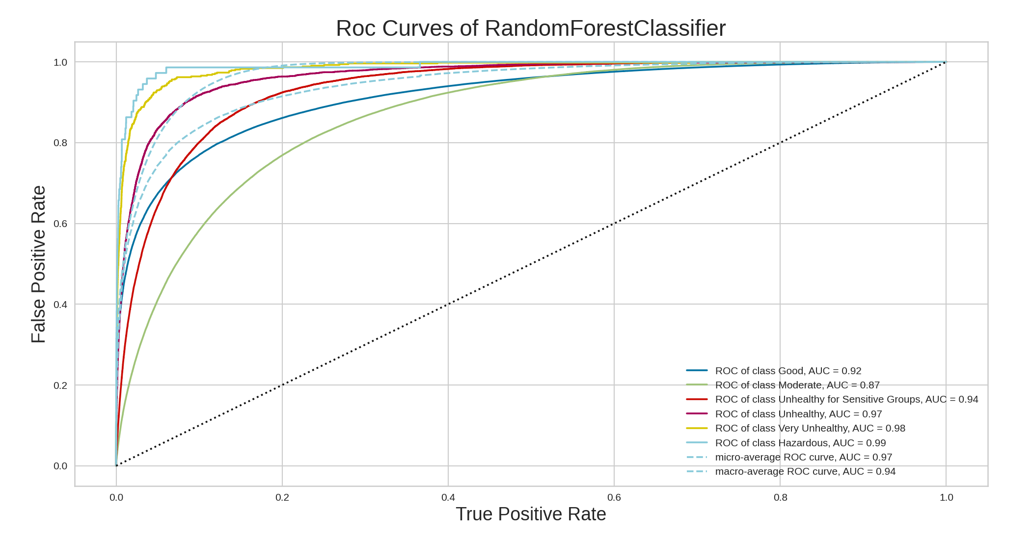
Model Evaluation
Score on train : 0.835
Score on test : 0.783

Slide 16
Regression Model
Algorithms to train
Linear Regression
Lasso
Ridge
XGBoost
XGBoost

Slide 17
Model Evaluation
Score on train : 0.873
Mean absolute error : 6.95
R2 score: 0.869
Root mean square error : 9.00

Slide 18
Conclusion
Some tests show a defect in the measurements, perhaps as a result of abnormal things that led to a defect during the tests.
The most important factor affecting (AQI) is the damage caused by the ozone, but it is less dangerous compared to the rest of the elements.
Successful model to predict (AQI) but in my opinion (AQI) value its very important and missing one can be cause a lot of problems so predict on location and datetime not enough to achieve the purpose, but the model can be powerful and accurate if additional data added such as weather details, air and industrial pollution information.

